Slide 1

APRIL 2022
IS FACIAL EXPRESSION AND GENDERS AFFECT OUR MEMORY?
PSY 458 Experimental Psychology (42070)
Professor David L Gilden
Present by
Jedsada Thavornfung (JT43227)
B.S, Psychology, The University of Texas at Austin
Notes:
Title slide (1 slide). Title of the talk (probably the same as your paper), the names of all group members, the class and university names, and the date the talk is given.

Slide 2
INTRODUCTION
Introduction (typically 3-4 slides). Explain why your work is interesting. Place the study in context – how does it relate to / follow from the scientific literature on this subject. If it relates to any applied issues (e.g., environmental problems), mention this here. Use some pretty visuals (photographs, drawings, etc.) to get the audience excited about the issue and questions you are addressing. Clearly state your hypotheses.
Notes:
Introduction (typically 3-4 slides). Explain why your work is interesting. Place the study in context – how does it relate to / follow from the scientific literature on this subject. If it relates to any applied issues (e.g., environmental problems), mention this here. Use some pretty visuals (photographs, drawings, etc.) to get the audience excited about the issue and questions you are addressing. Clearly state your hypotheses.

Slide 3
PURPOSE
The purpose of this research is to study how facial expression and genders of a person have any effect on our ability to recall their faces. The facial expressions in this study are happy and sad faces. The gender of images in this study are male and female.
Introduction (typically 3-4 slides). Explain why your work is interesting. Place the study in context – how does it relate to / follow from the scientific literature on this subject. If it relates to any applied issues (e.g., environmental problems), mention this here. Use some pretty visuals (photographs, drawings, etc.) to get the audience excited about the issue and questions you are addressing. Clearly state your hypotheses.
Notes:
Introduction (typically 3-4 slides). Explain why your work is interesting. Place the study in context – how does it relate to / follow from the scientific literature on this subject. If it relates to any applied issues (e.g., environmental problems), mention this here. Use some pretty visuals (photographs, drawings, etc.) to get the audience excited about the issue and questions you are addressing. Clearly state your hypotheses.

Slide 4
BACKGROUND
This study is conducted because I am interested in investigating if facial expressions and their gender correlate to how people memorize other people. For instance, would participants remember someone better if they have specific facial expressions when they meet for the first time? If certain facial expressions improve memory recollection, does it have the same effect for both males and females?
This study is important because it could improve the first impression on certain circumstances: during the interviews, dates, meeting with new people, etc.
Notes:
Introduction (typically 3-4 slides). Explain why your work is interesting. Place the study in context – how does it relate to / follow from the scientific literature on this subject. If it relates to any applied issues (e.g., environmental problems), mention this here. Use some pretty visuals (photographs, drawings, etc.) to get the audience excited about the issue and questions you are addressing. Clearly state your hypotheses.

Slide 5
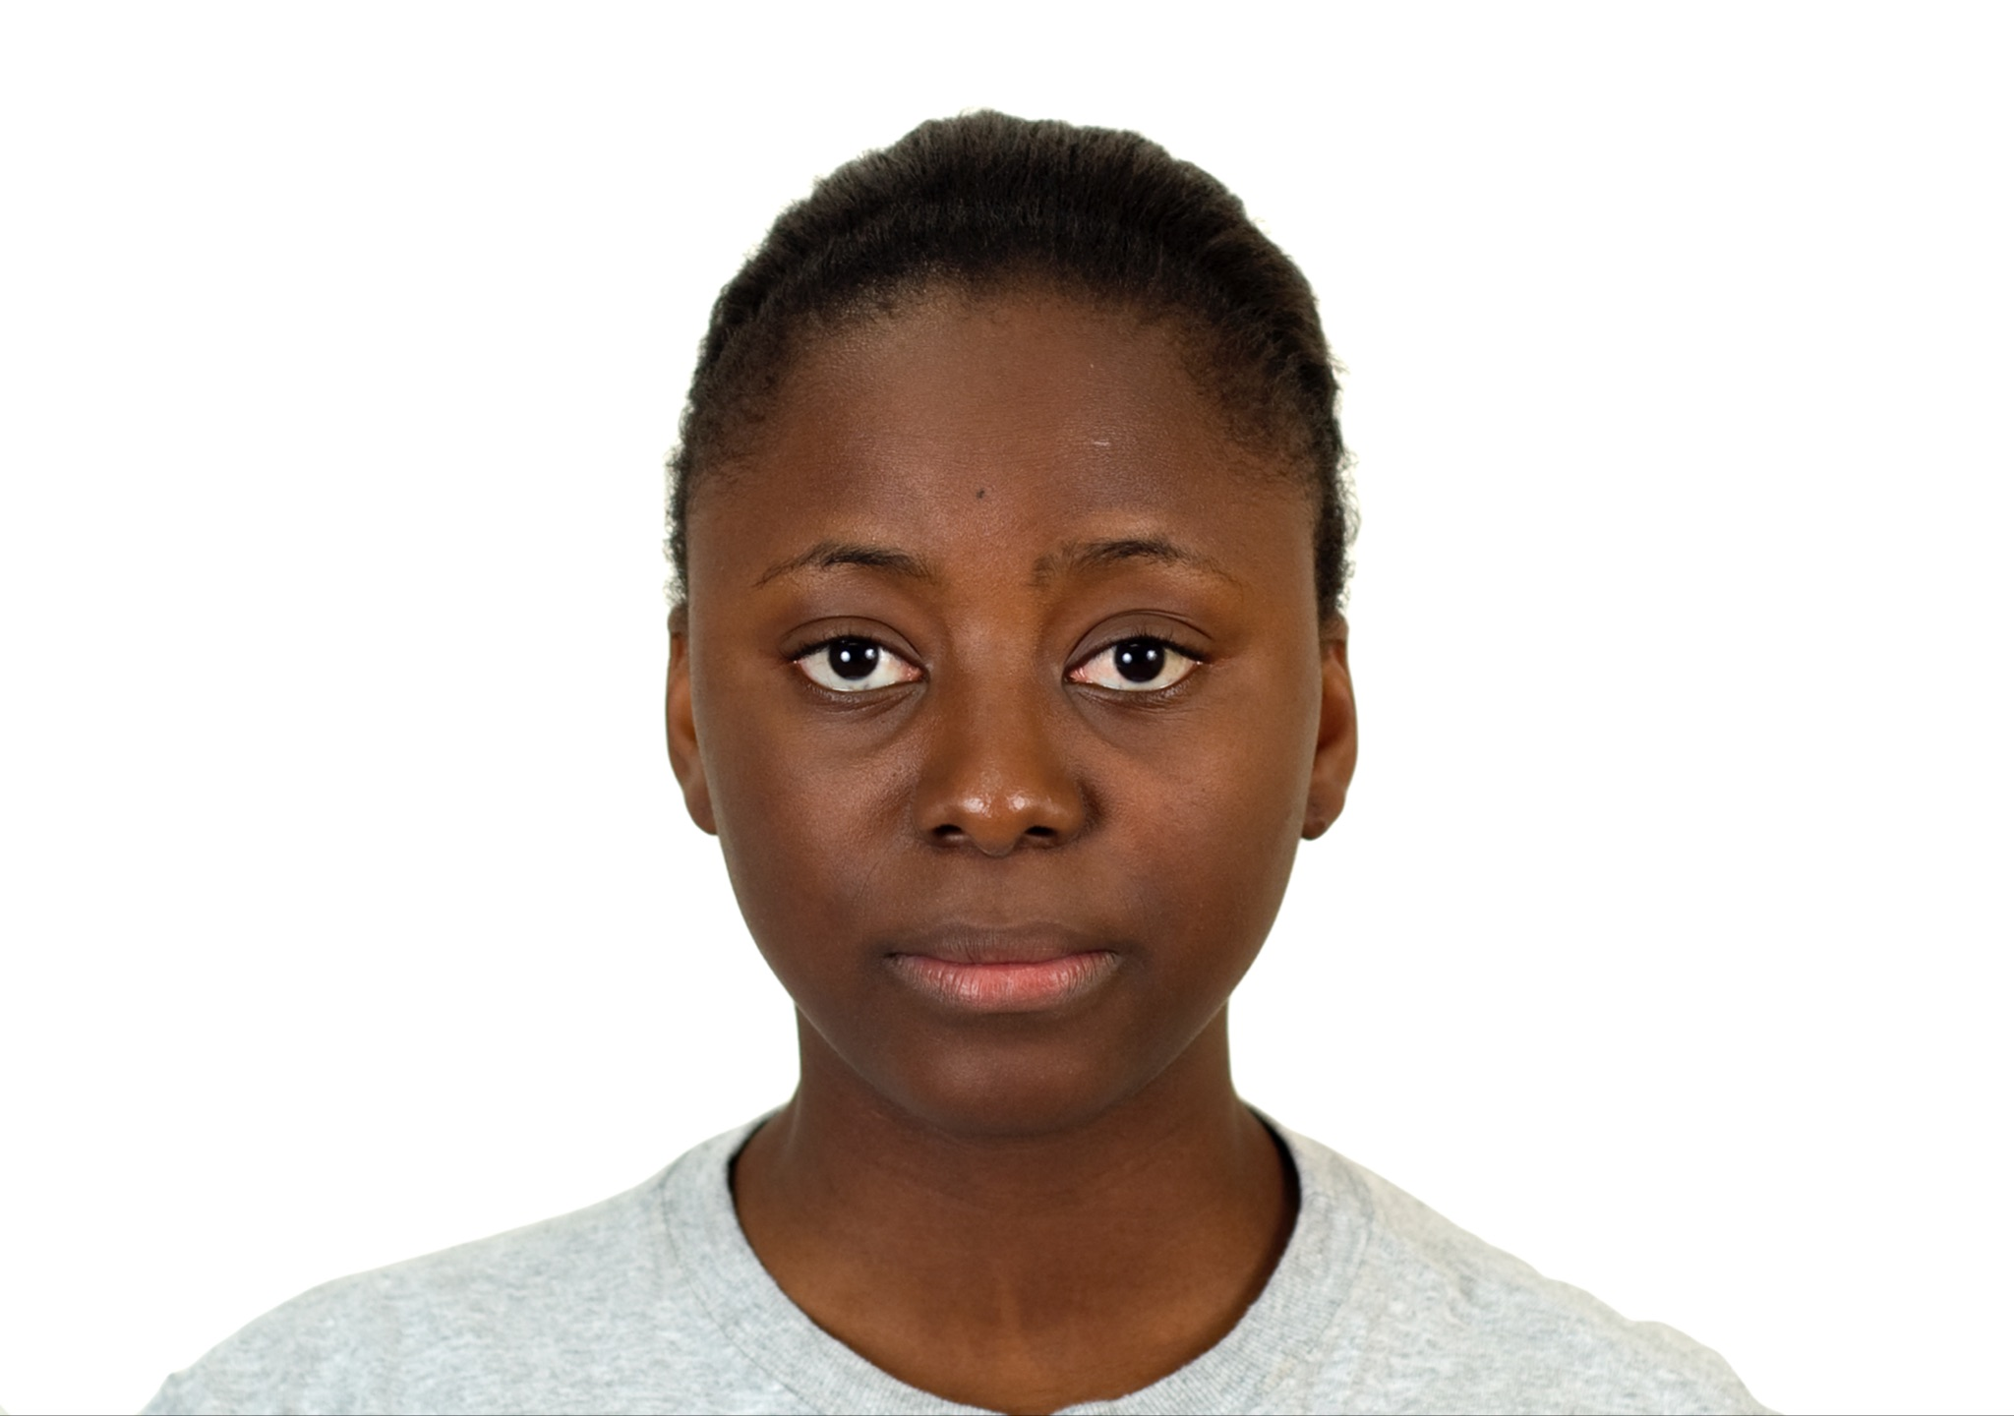
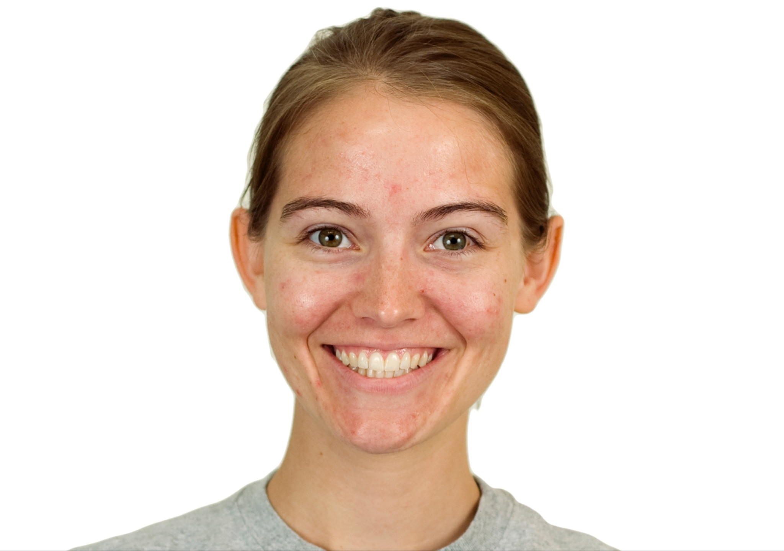
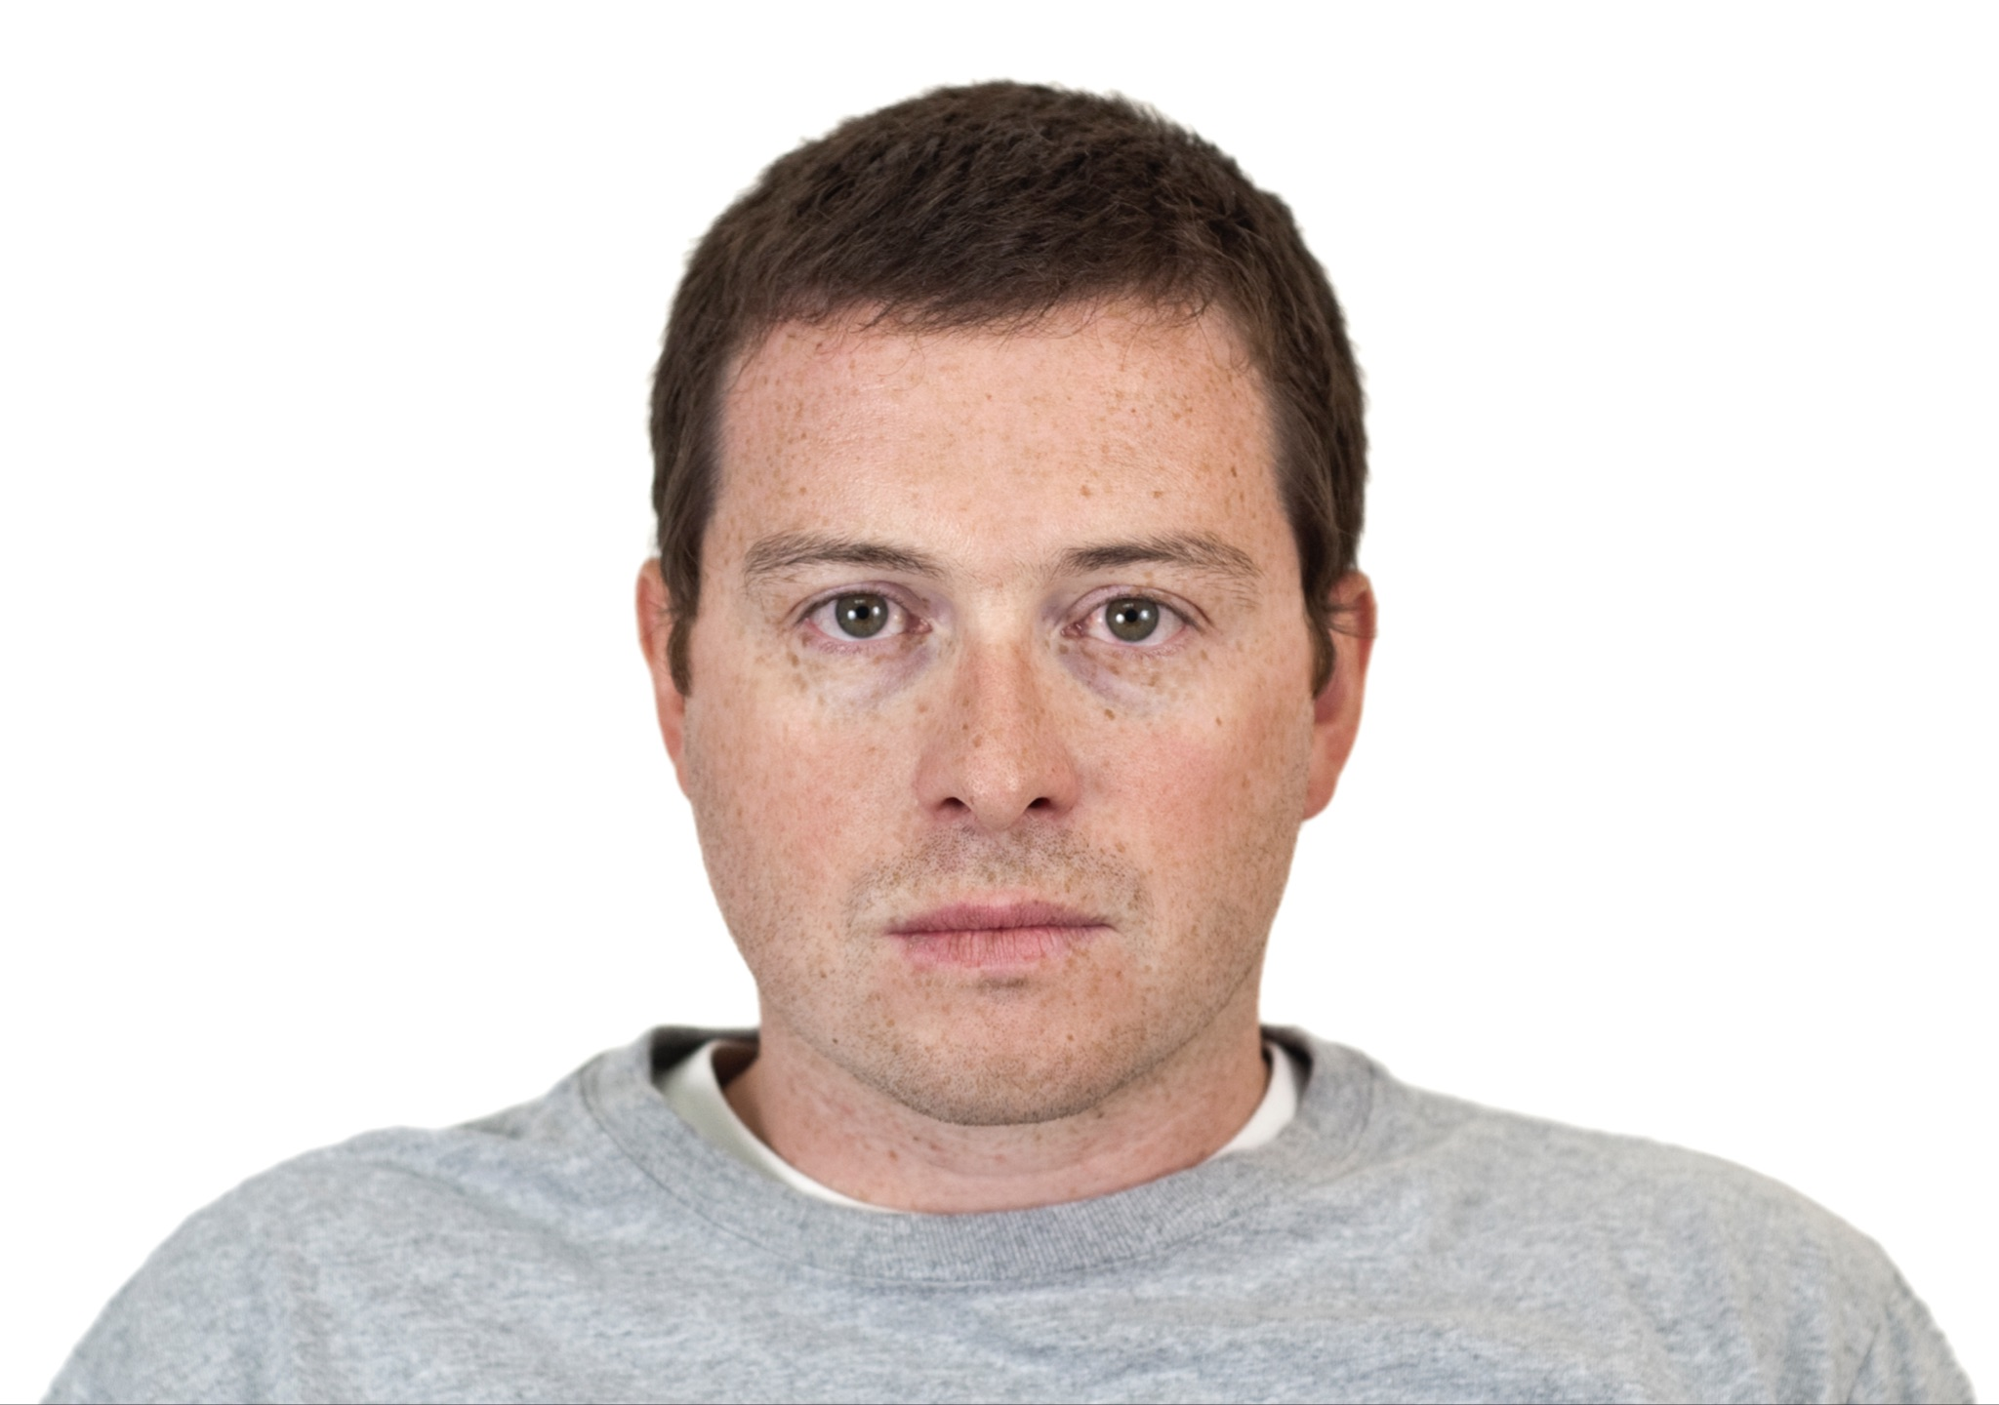
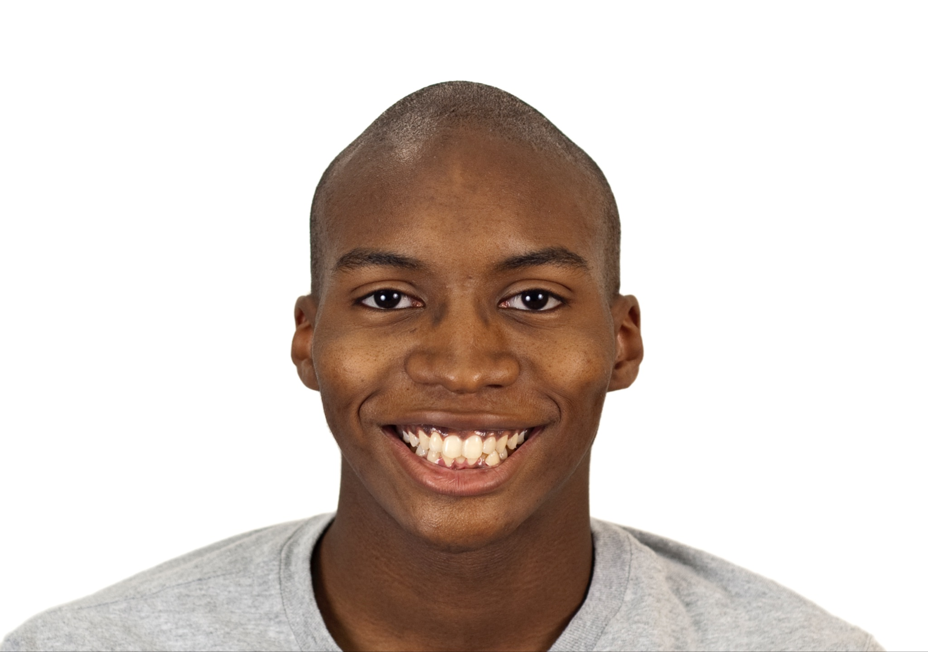
HYPOTHESIS
Null Hypothesis: Facial expression and gender of the images will have no effect on memory.
Alternative Hypothesis: Facial expression and gender of the images have an effect on memory
Notes:
Introduction (typically 3-4 slides). Explain why your work is interesting. Place the study in context – how does it relate to / follow from the scientific literature on this subject. If it relates to any applied issues (e.g., environmental problems), mention this here. Use some pretty visuals (photographs, drawings, etc.) to get the audience excited about the issue and questions you are addressing. Clearly state your hypotheses.

Slide 6
Materials and Methods (typically 2-3 slides). Clearly summarize the design. Show a picture of your organisms and justify why they are appropriate for addressing the questions mentioned above. Show a picture of your lab setup and/or of a person doing some of the lab work. Show a diorama of your experimental design (with sample sizes, number of replicates, sampling frequency, etc.). Mention what parameters you measured but do not go into detail on exact procedures used. Do state what statistical tests you used to analyze your data.
METHOD
Notes:
Materials and Methods (typically 2-3 slides). Clearly summarize the design. Show a picture of your organisms and justify why they are appropriate for addressing the questions mentioned above. Show a picture of your lab setup and/or of a person doing some of the lab work. Show a diorama of your experimental design (with sample sizes, number of replicates, sampling frequency, etc.). Mention what parameters you measured but do not go into detail on exact procedures used. Do state what statistical tests you used to analyze your data.

Slide 7
PROCEDURE
Participants will be taking the experiment on the computer: laptop. The experiment will run by PsychoPy program. First, six images of people with either happy or sad expression will shown to participants to memorize. Participants will have 1.5 seconds to see each images. Second, once the images have been shown, the same people with both facial expressions will be shown to participants (twelve images). Then, participants will be asked to identify which images have the same expression as the images that being shown in the first step. There were 6 sets of images in total. Participants also have a break between each set.
Materials and Methods (typically 2-3 slides). Clearly summarize the design. Show a picture of your organisms and justify why they are appropriate for addressing the questions mentioned above. Show a picture of your lab setup and/or of a person doing some of the lab work. Show a diorama of your experimental design (with sample sizes, number of replicates, sampling frequency, etc.). Mention what parameters you measured but do not go into detail on exact procedures used. Do state what statistical tests you used to analyze your data.
Notes:
Materials and Methods (typically 2-3 slides). Clearly summarize the design. Show a picture of your organisms and justify why they are appropriate for addressing the questions mentioned above. Show a picture of your lab setup and/or of a person doing some of the lab work. Show a diorama of your experimental design (with sample sizes, number of replicates, sampling frequency, etc.). Mention what parameters you measured but do not go into detail on exact procedures used. Do state what statistical tests you used to analyze your data.

Slide 8
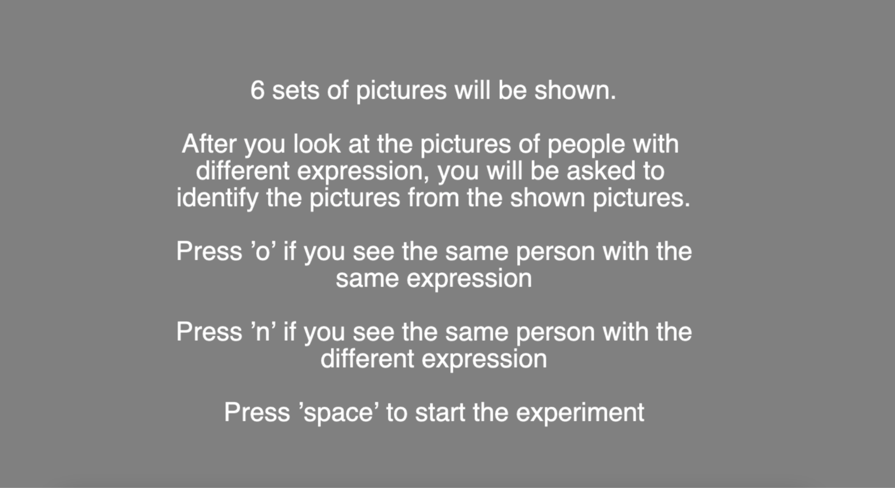
INSTRUCTION
Materials and Methods (typically 2-3 slides). Clearly summarize the design. Show a picture of your organisms and justify why they are appropriate for addressing the questions mentioned above. Show a picture of your lab setup and/or of a person doing some of the lab work. Show a diorama of your experimental design (with sample sizes, number of replicates, sampling frequency, etc.). Mention what parameters you measured but do not go into detail on exact procedures used. Do state what statistical tests you used to analyze your data.
Notes:
Materials and Methods (typically 2-3 slides). Clearly summarize the design. Show a picture of your organisms and justify why they are appropriate for addressing the questions mentioned above. Show a picture of your lab setup and/or of a person doing some of the lab work. Show a diorama of your experimental design (with sample sizes, number of replicates, sampling frequency, etc.). Mention what parameters you measured but do not go into detail on exact procedures used. Do state what statistical tests you used to analyze your data.

Slide 9
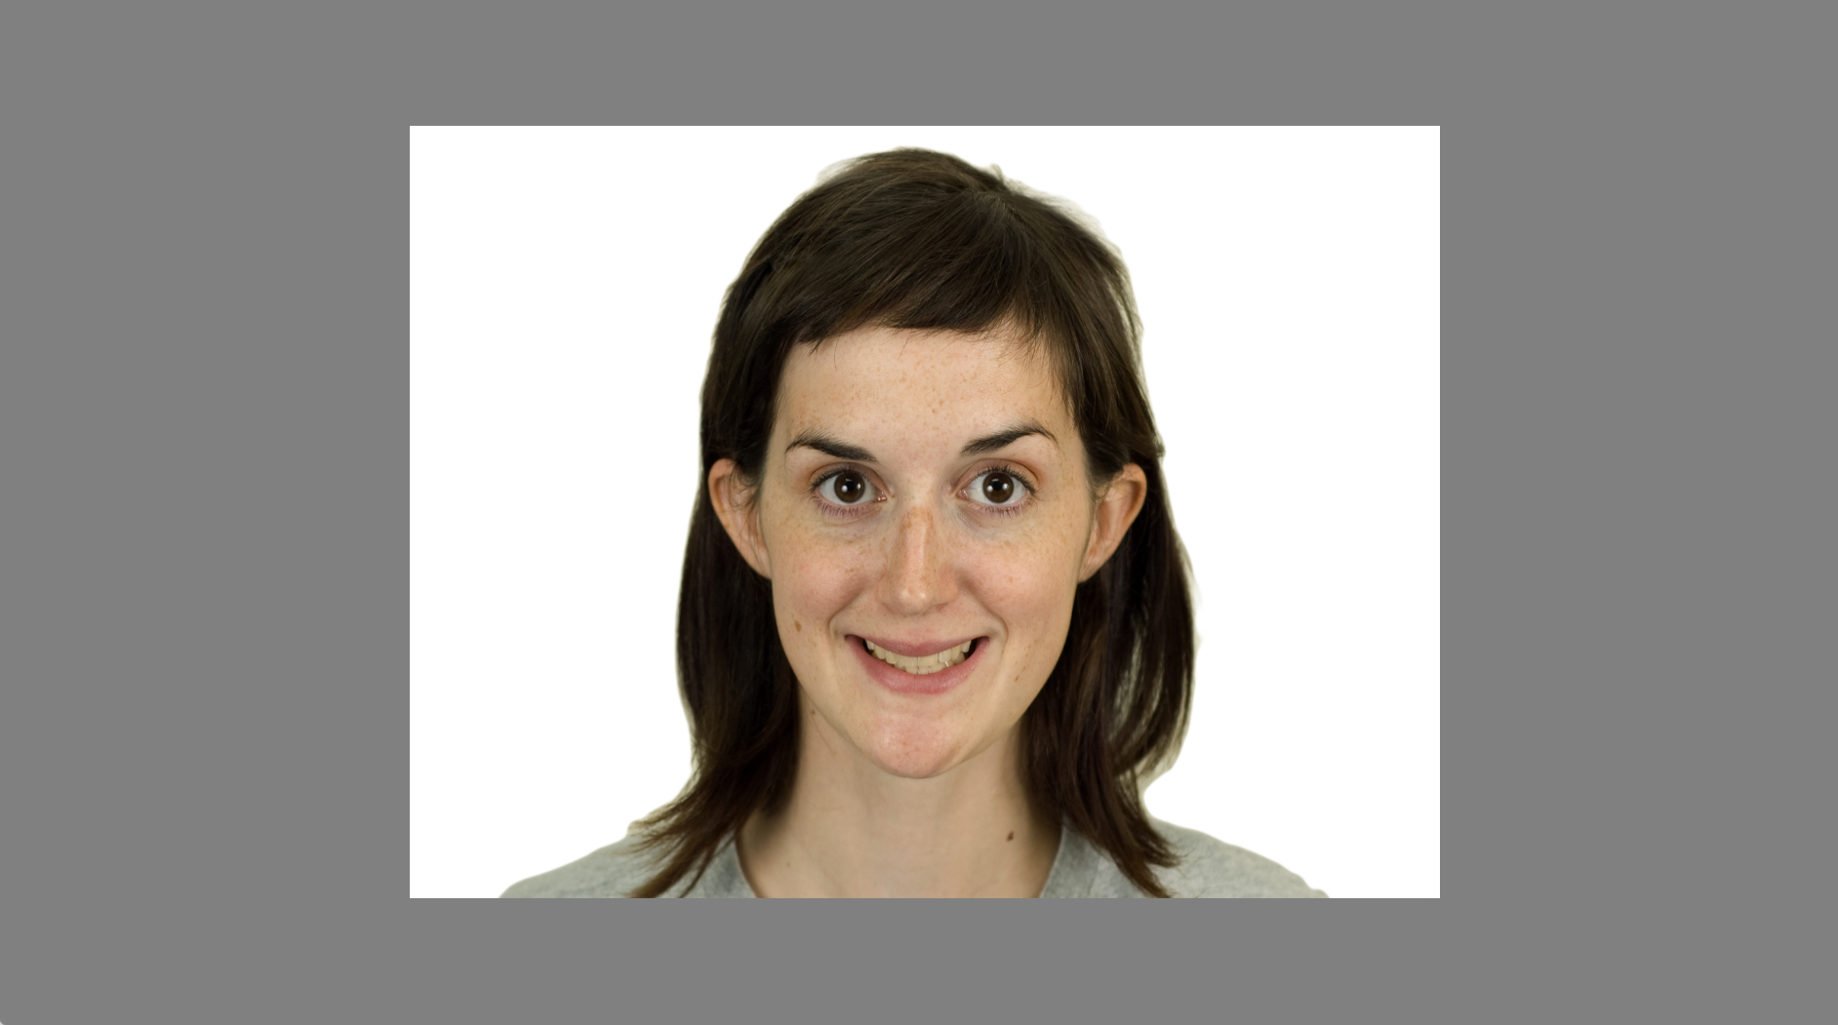
FACIAL EXPRESSION EXAMPLE
Materials and Methods (typically 2-3 slides). Clearly summarize the design. Show a picture of your organisms and justify why they are appropriate for addressing the questions mentioned above. Show a picture of your lab setup and/or of a person doing some of the lab work. Show a diorama of your experimental design (with sample sizes, number of replicates, sampling frequency, etc.). Mention what parameters you measured but do not go into detail on exact procedures used. Do state what statistical tests you used to analyze your data.
Notes:
Materials and Methods (typically 2-3 slides). Clearly summarize the design. Show a picture of your organisms and justify why they are appropriate for addressing the questions mentioned above. Show a picture of your lab setup and/or of a person doing some of the lab work. Show a diorama of your experimental design (with sample sizes, number of replicates, sampling frequency, etc.). Mention what parameters you measured but do not go into detail on exact procedures used. Do state what statistical tests you used to analyze your data.

Slide 10
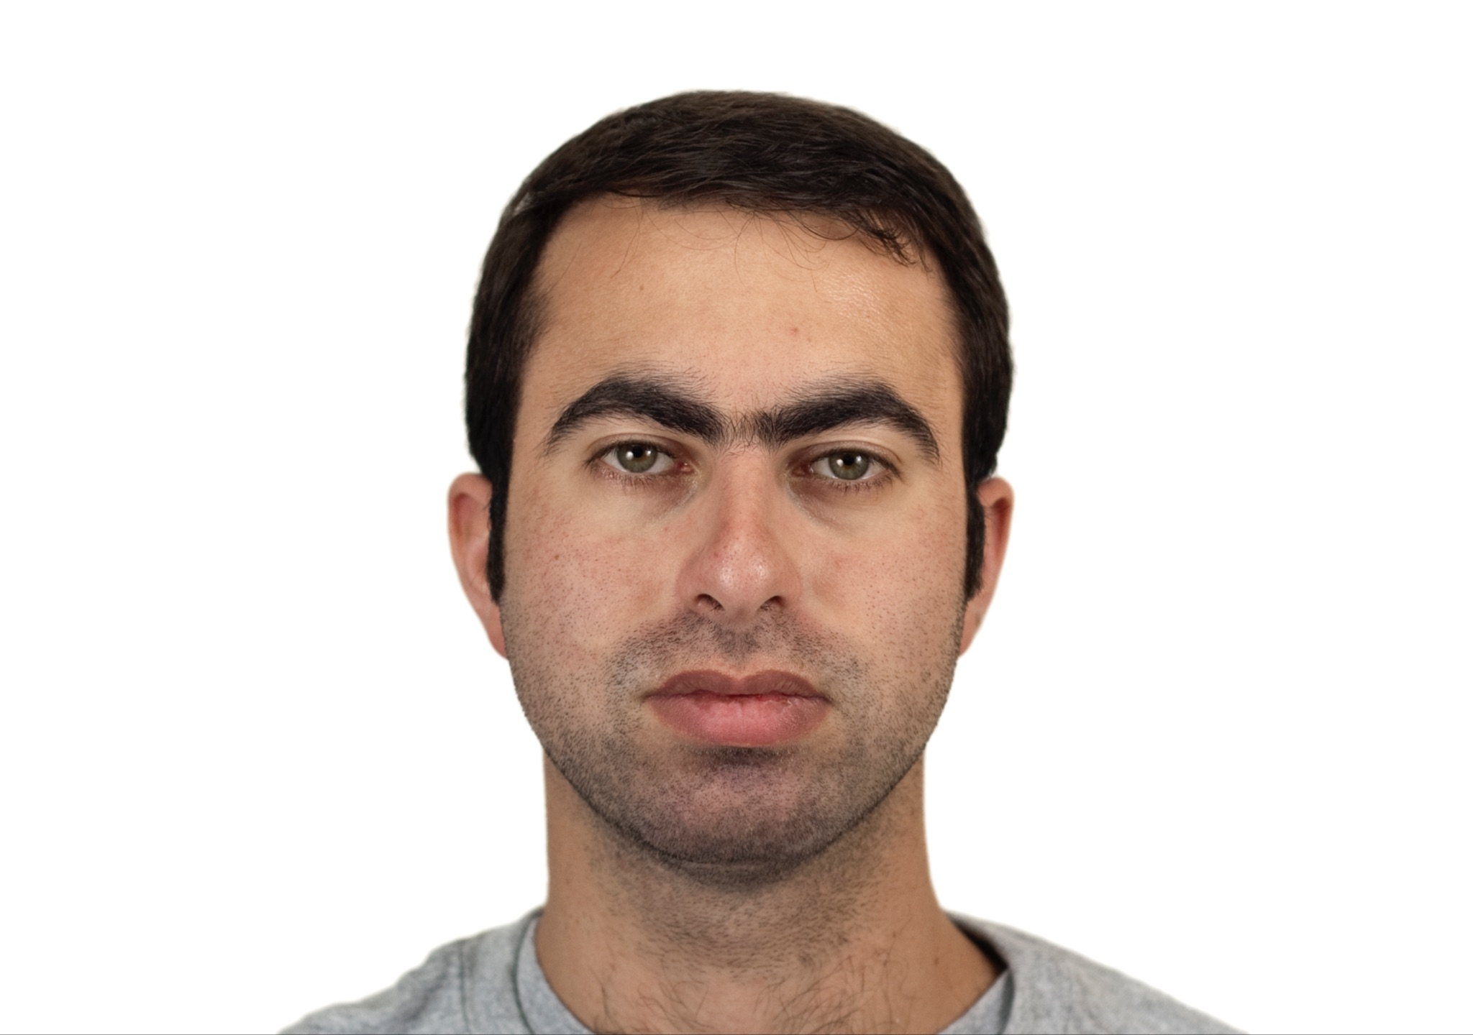
Male + Sad Expression

Slide 11

Male + Happy Expression

Slide 12
Female + Sad Expression

Slide 13
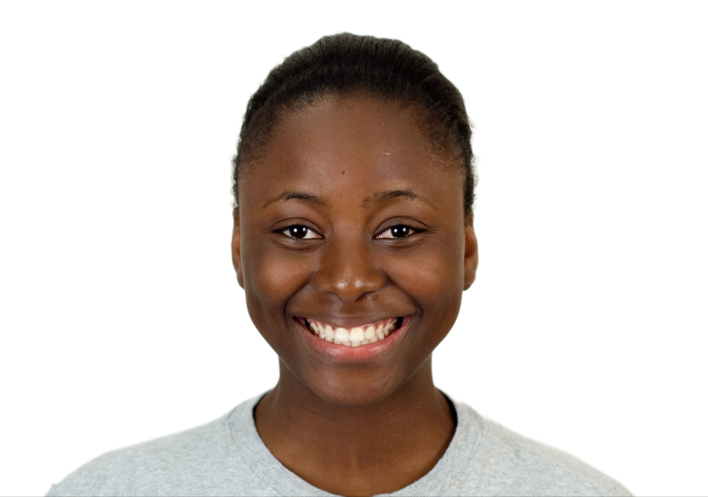
Female + Happy Expression

Slide 14
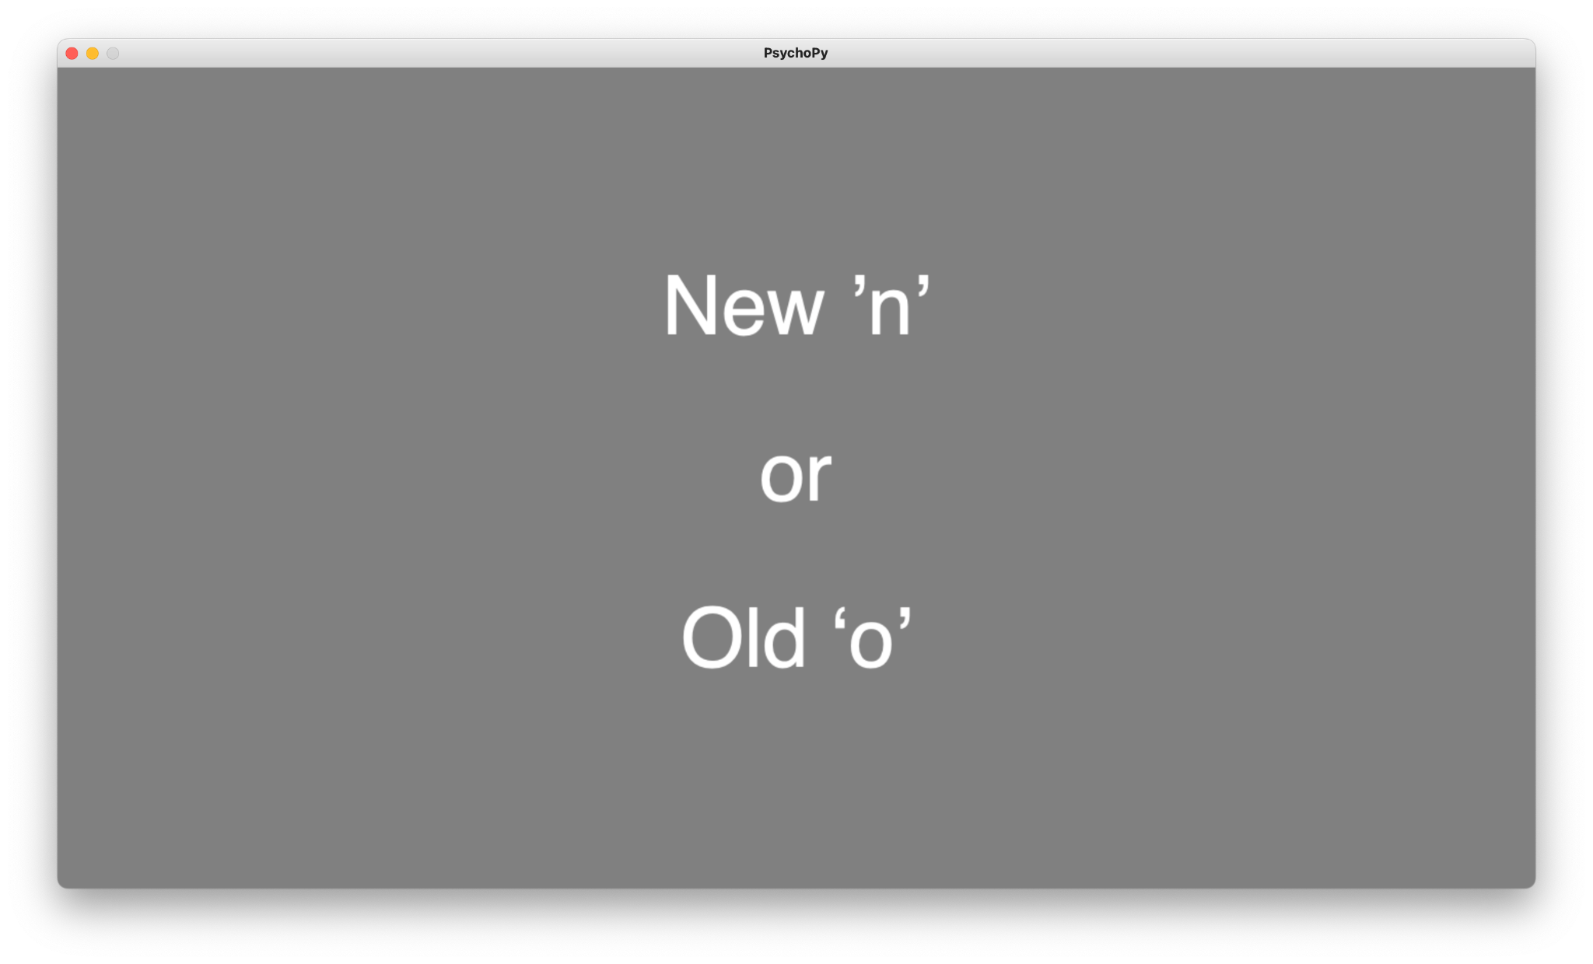
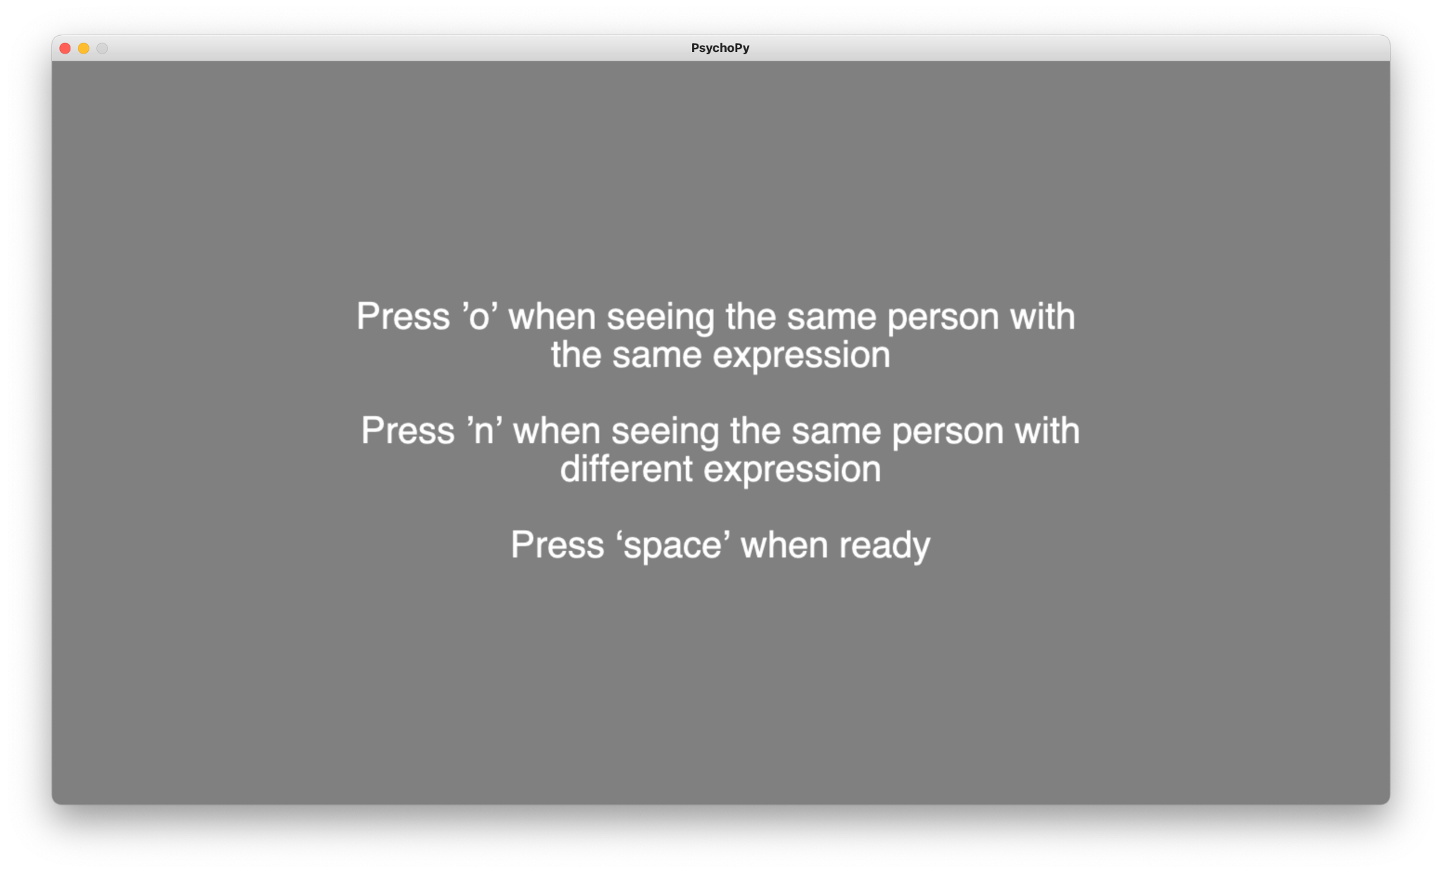
ANSWERING PHASE SAMPLE
Materials and Methods (typically 2-3 slides). Clearly summarize the design. Show a picture of your organisms and justify why they are appropriate for addressing the questions mentioned above. Show a picture of your lab setup and/or of a person doing some of the lab work. Show a diorama of your experimental design (with sample sizes, number of replicates, sampling frequency, etc.). Mention what parameters you measured but do not go into detail on exact procedures used. Do state what statistical tests you used to analyze your data.
Notes:
Materials and Methods (typically 2-3 slides). Clearly summarize the design. Show a picture of your organisms and justify why they are appropriate for addressing the questions mentioned above. Show a picture of your lab setup and/or of a person doing some of the lab work. Show a diorama of your experimental design (with sample sizes, number of replicates, sampling frequency, etc.). Mention what parameters you measured but do not go into detail on exact procedures used. Do state what statistical tests you used to analyze your data.

Slide 15
Within-Subject Design
Participants:
N = 20 (Male = 10; Female = 10)
Age average = 21 years old (range from 20 - 37 years old)
Total Images = 72 images
Female = 36 images
Male = 36 images
Image with the same expression = 36 images
Image with the different expression = 36 images
Materials and Methods (typically 2-3 slides). Clearly summarize the design. Show a picture of your organisms and justify why they are appropriate for addressing the questions mentioned above. Show a picture of your lab setup and/or of a person doing some of the lab work. Show a diorama of your experimental design (with sample sizes, number of replicates, sampling frequency, etc.). Mention what parameters you measured but do not go into detail on exact procedures used. Do state what statistical tests you used to analyze your data.
Notes:
Materials and Methods (typically 2-3 slides). Clearly summarize the design. Show a picture of your organisms and justify why they are appropriate for addressing the questions mentioned above. Show a picture of your lab setup and/or of a person doing some of the lab work. Show a diorama of your experimental design (with sample sizes, number of replicates, sampling frequency, etc.). Mention what parameters you measured but do not go into detail on exact procedures used. Do state what statistical tests you used to analyze your data.

Slide 16
Results (typically 2-4 slides). First show a photograph (or sketch) that shows an interesting qualitative results (e.g., trays of plants in which one set is noticeably bigger than the other, a drawing of a happy Daphnia) and state that result. Then display the results in graphical form, reminding the audience of your hypothesis and stating whether it was supported as you do so. Use simple, clean, clearly labeled graphs with proper axis labels (no extraneous 3-D effects please). Do not use light colors (yellow, light green, or pink) in your figures, they do not show up well when projected. Indicate the results of the statistical tests on the slides by including p- values (or asterisks/letters that indicate the significance level) on the same slides with the graphs. If you have multiple results, state them in a logical order.
RESULTS
Notes:
Results (typically 2-4 slides). First show a photograph (or sketch) that shows an interesting qualitative results (e.g., trays of plants in which one set is noticeably bigger than the other, a drawing of a happy Daphnia) and state that result. Then display the results in graphical form, reminding the audience of your hypothesis and stating whether it was supported as you do so. Use simple, clean, clearly labeled graphs with proper axis labels (no extraneous 3-D effects please). Do not use light colors (yellow, light green, or pink) in your figures, they do not show up well when projected. Indicate the results of the statistical tests on the slides by including p- values (or asterisks/letters that indicate the significance level) on the same slides with the graphs. If you have multiple results, state them in a logical order.

Slide 17
 | Average
 | Male Participants | Female Participants
Age (year olds) | 21.1 | 22
Correction Rates (out of 100%) | 82.36% | 79.71%
Incorrect Response (out of 72 images) | 12.7 | 15
Happy Face Incorrect (out of 36 images) | 5.6 | 7.6
Sad Face Incorrect (out of 36 images) | 7.1 | 7.4
Results (typically 2-4 slides). First show a photograph (or sketch) that shows an interesting qualitative results (e.g., trays of plants in which one set is noticeably bigger than the other, a drawing of a happy Daphnia) and state that result. Then display the results in graphical form, reminding the audience of your hypothesis and stating whether it was supported as you do so. Use simple, clean, clearly labeled graphs with proper axis labels (no extraneous 3-D effects please). Do not use light colors (yellow, light green, or pink) in your figures, they do not show up well when projected. Indicate the results of the statistical tests on the slides by including p- values (or asterisks/letters that indicate the significance level) on the same slides with the graphs. If you have multiple results, state them in a logical order.
Notes:
Results (typically 2-4 slides). First show a photograph (or sketch) that shows an interesting qualitative results (e.g., trays of plants in which one set is noticeably bigger than the other, a drawing of a happy Daphnia) and state that result. Then display the results in graphical form, reminding the audience of your hypothesis and stating whether it was supported as you do so. Use simple, clean, clearly labeled graphs with proper axis labels (no extraneous 3-D effects please). Do not use light colors (yellow, light green, or pink) in your figures, they do not show up well when projected. Indicate the results of the statistical tests on the slides by including p- values (or asterisks/letters that indicate the significance level) on the same slides with the graphs. If you have multiple results, state them in a logical order.

Slide 18
Detection theory or signal detection theory is a means to measure the ability to differentiate between information-bearing patterns and random patterns that distract from the information.
Old Picture
New Pictures
Participant’s response
Hit | Miss
False Alarm | Correct Rejection
Old Picture
Shown images
New Pictures
…..
Notes:
SDT assumes that performance is not perfect and describes how well observers can discriminate or recognize certain signals given the background noise. For example, in recognition memory studies, participants need to decide if a specific stimulus has been presented or not (old or new). There is some ambiguity in this decision, so that given the same stimulus, a participant may judge it as either old or new. SDT captures sensitivity in discriminatory ability so that higher sensitivity means the participant is better able to discriminate old from new items.

Slide 19
WHY?
Signal detection theory is used because it takes response bias into account. Signal detection theory attributes responses to a combination of sensitivity and bias. Sensitivity is what we are interested in, while bias is what we have to take into account to recover sensitivity. By using detection theory, we conceive of sensitivity as (broadly) detecting a signal (e.g. against background noise, or compared to another signal), and model how a perceiver decides whether a signal is present.
Notes:
SDT assumes that performance is not perfect and describes how well observers can discriminate or recognize certain signals given the background noise. For example, in recognition memory studies, participants need to decide if a specific stimulus has been presented or not (old or new). There is some ambiguity in this decision, so that given the same stimulus, a participant may judge it as either old or new. SDT captures sensitivity in discriminatory ability so that higher sensitivity means the participant is better able to discriminate old from new items.

Slide 20
EQUATION
Hits - False Alarm
D’ =
Hits + False Alarm
Higher D’ = Higher Hits than False Alarm.
Lower D’ = Higher False Alarm than Hits.
Notes:
sensitivity and bias are usually calculated at each individual participant level. This is because sensitivity and bias describe the perceptions of individual participants and can differ from person to person. Some people may be better at discriminating certain stimuli than others and some people may tend to say “yes” or “no” more than others.

Slide 21
Sex of Participants | Percent Correct (%) | Women + Happy Faces | Women + Sad Faces | Men + Happy Faces | Men + Sad Faces
F | 95.83 | 0.60 | 1.00 | 1.00 | 1.00
F | 100 | 1.00 | 1.00 | 1.00 | 1.00
F | 75 | 0.40 | 1.00 | 0.14 | 0.33
F | 68.06 | 0.27 | 0.64 | -0.08 | 0.33
F | 72.22 | 0.40 | 0.33 | 0.23 | 0.56
F | 83.33 | 1.00 | 0.75 | 0.75 | 0.75
F | 55.56 | 0.11 | 0.27 | -0.13 | 0.33
F | 69.44 | 0.25 | 0.56 | 0.17 | 0.56
F | 81.94 | 0.60 | 0.75 | 0.71 | 0.75
F | 90.28 | 1.00 | 0.50 | 0.60 | 0.80
M | 68.06 | 0.27 | 0.23 | 0.43 | 0.33
M | 95.83 | 0.78 | 0.67 | 1.00 | 1.00
M | 95.83 | 1.00 | 0.82 | 1.00 | 0.82
M | 81.94 | 0.50 | 0.64 | 0.56 | 0.64
M | 90.28 | 0.40 | 0.82 | 0.78 | 0.82
M | 86.11 | 0.71 | 0.80 | 0.75 | 0.78
M | 72.22 | 1.00 | 0.40 | 0.78 | 0.45
M | 83.33 | 0.40 | 0.67 | 0.56 | 0.64
M | 69.44 | 0.40 | 0.56 | 0.33 | 0.09
M | 80.56 | 0.45 | 0.78 | 0.64 | 0.33

Slide 22
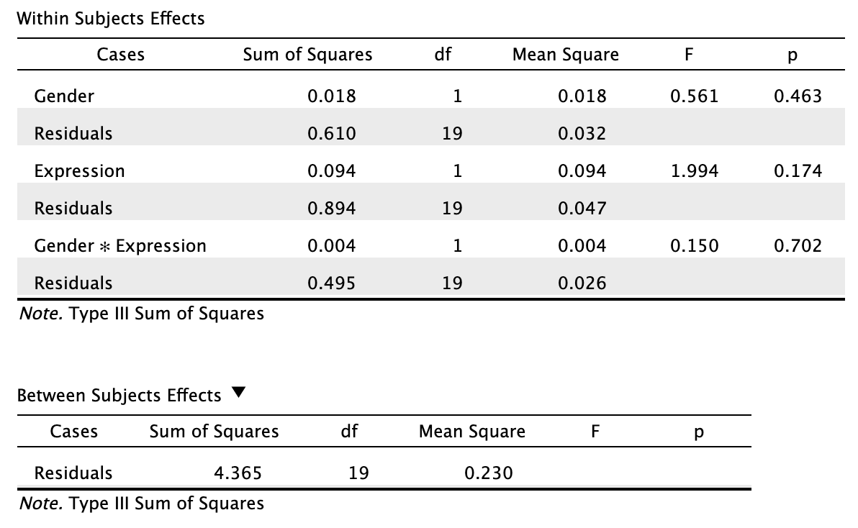
Repeated Measures ANOVA
(All Participants)
> 0.05,
Insignificant

Slide 23
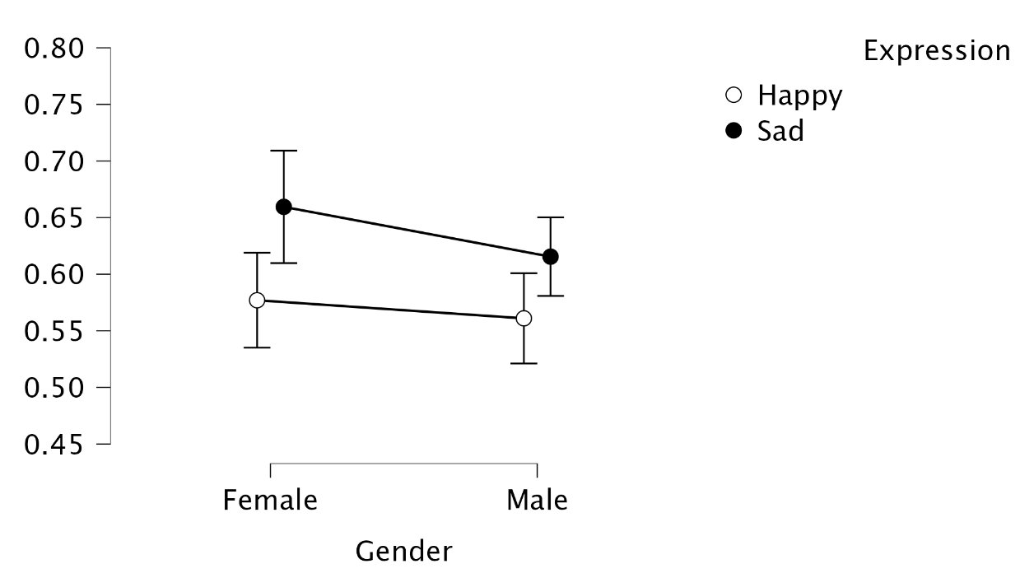
Descriptives Plots
(All Participants)

Slide 24
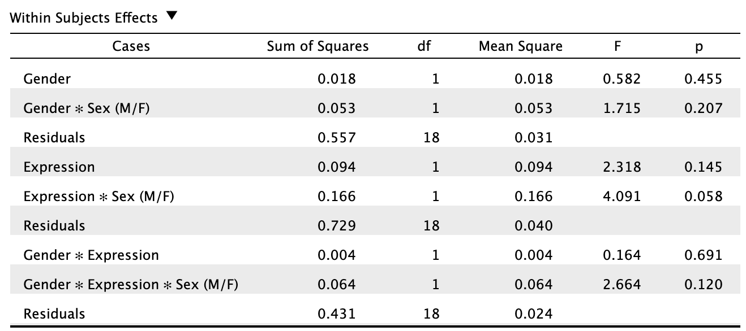
Repeated Measures ANOVA
(Male vs Female Participants)
> 0.05,
Insignificant

Slide 25
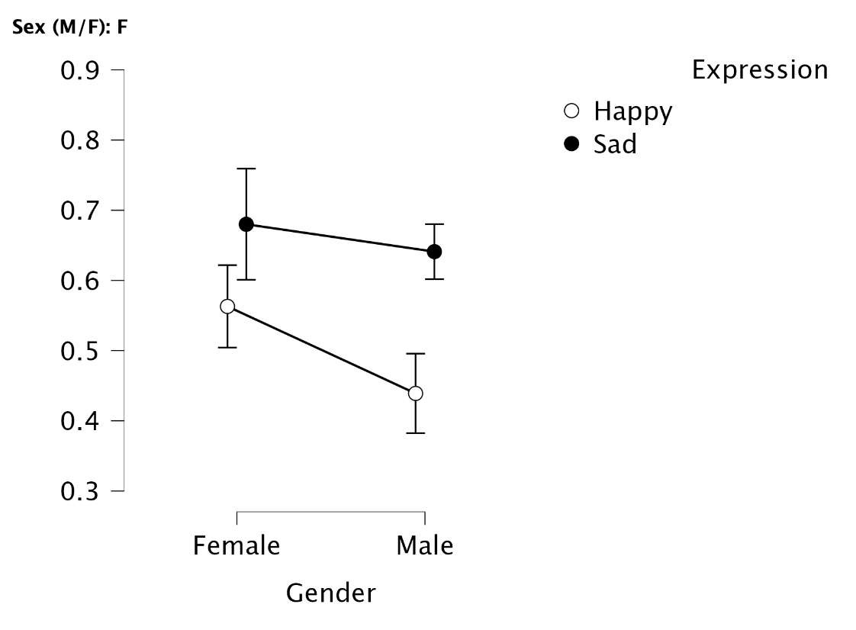
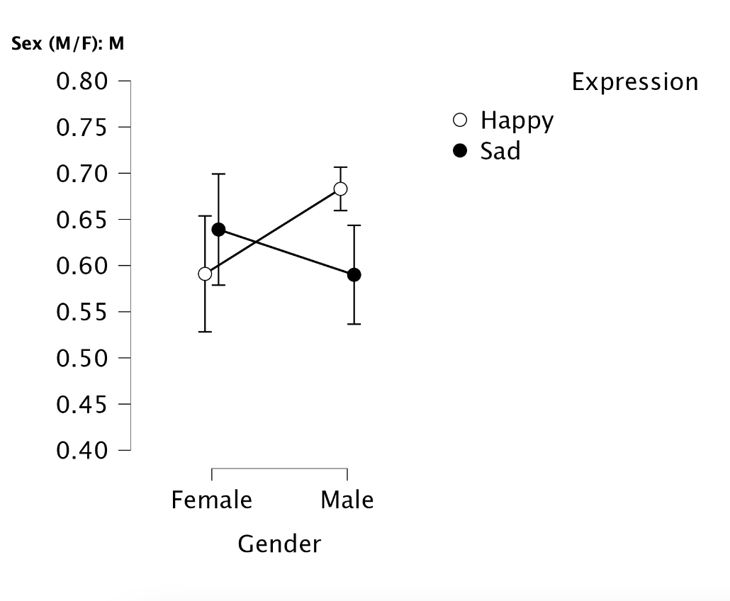
Descriptives Plots
(Male Participants)
(Female Participants)

Slide 26
All participants:
Remember sad expression better than happy expression on both gender of images.
There are very small difference between happy expression on both genders.
Female Participants:
Remember women face better than male faces on both expression.
Remember sad expression better than happy expression on both gender of images.
Male Participants:
Sad Expression: remember sad women faces better than happy women faces.
Happy Expression: remember happy men faces better than sad men faces.
Notes:
Implications and Conclusions (typically 2-3 slides). Correctly interpret your results. Constructively address sources of error and methodological difficulties. Place your results in context and draw implications from them.

Slide 27
Sex of Participants | Percent Correct (%) | Women + Happy Faces | Women + Sad Faces | Men + Happy Faces | Men + Sad Faces
F | 95.83 | 0.60 | 1.00 | 1.00 | 1.00
F | 100 | 1.00 | 1.00 | 1.00 | 1.00
F | 75 | 0.40 | 1.00 | 0.14 | 0.33
F | 68.06 | 0.27 | 0.64 | -0.08 | 0.33
F | 72.22 | 0.40 | 0.33 | 0.23 | 0.56
F | 83.33 | 1.00 | 0.75 | 0.75 | 0.75
F | 55.56 | 0.11 | 0.27 | -0.13 | 0.33
F | 69.44 | 0.25 | 0.56 | 0.17 | 0.56
F | 81.94 | 0.60 | 0.75 | 0.71 | 0.75
F | 90.28 | 1.00 | 0.50 | 0.60 | 0.80
M | 68.06 | 0.27 | 0.23 | 0.43 | 0.33
M | 95.83 | 0.78 | 0.67 | 1.00 | 1.00
M | 95.83 | 1.00 | 0.82 | 1.00 | 0.82
M | 81.94 | 0.50 | 0.64 | 0.56 | 0.64
M | 90.28 | 0.40 | 0.82 | 0.78 | 0.82
M | 86.11 | 0.71 | 0.80 | 0.75 | 0.78
M | 72.22 | 1.00 | 0.40 | 0.78 | 0.45
M | 83.33 | 0.40 | 0.67 | 0.56 | 0.64
M | 69.44 | 0.40 | 0.56 | 0.33 | 0.09
M | 80.56 | 0.45 | 0.78 | 0.64 | 0.33

Slide 28
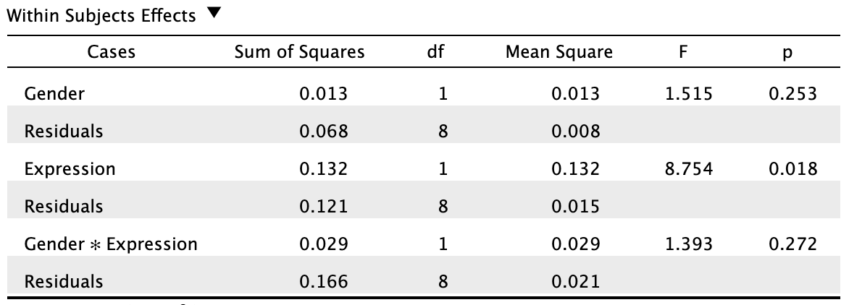
Repeated Measures ANOVA
< 0.05,
Significant
(All Participants)
> 0.05,
Insignificant

Slide 29
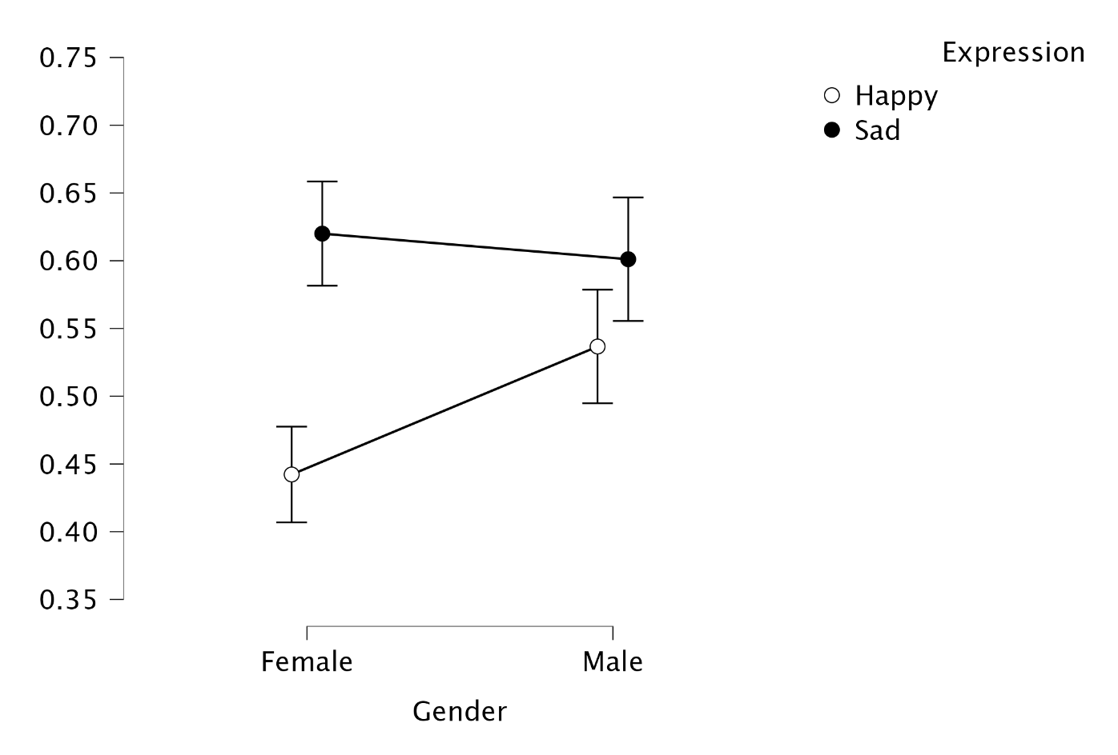
Descriptives Plots (Without Outline)
(All Participants)

Slide 30
WITH OUTLINE
WITHOUT OUTLINE
(All Participants)
(All Participants)

Slide 31
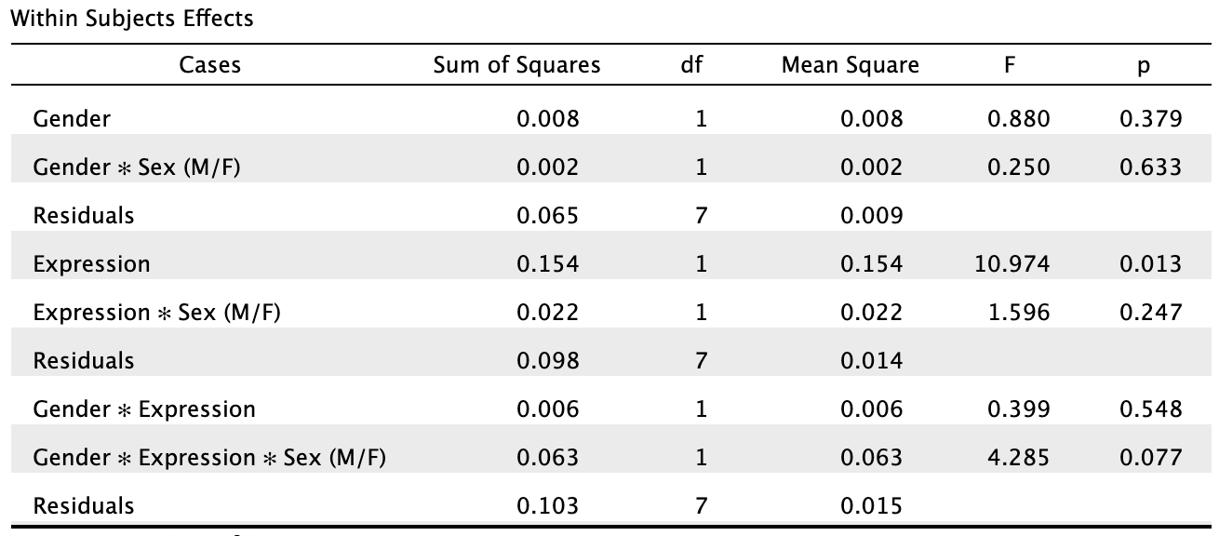
Repeated Measures ANOVA
(Male vs Female Participants)
> 0.05,
Insignificant

Slide 32
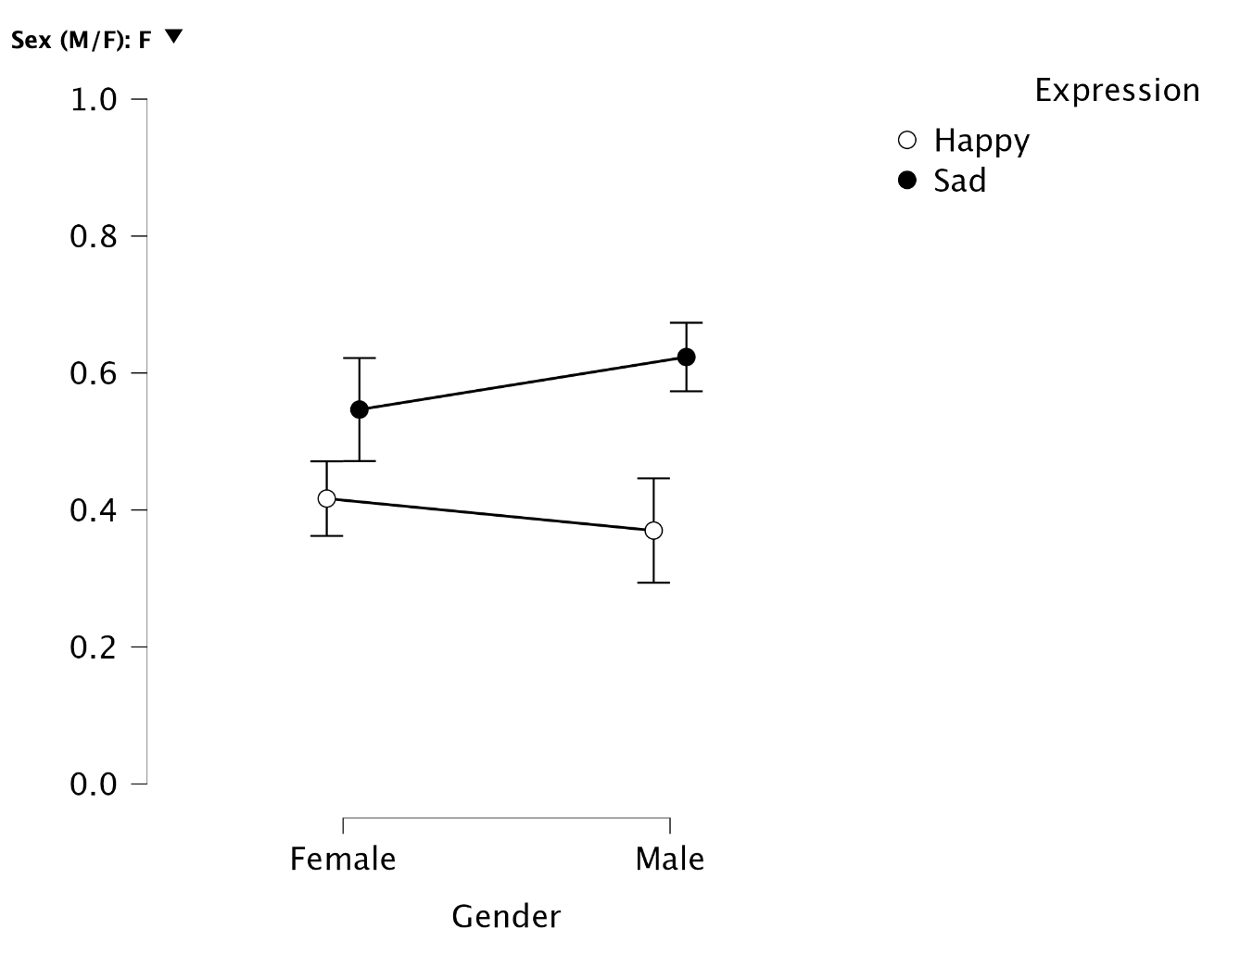
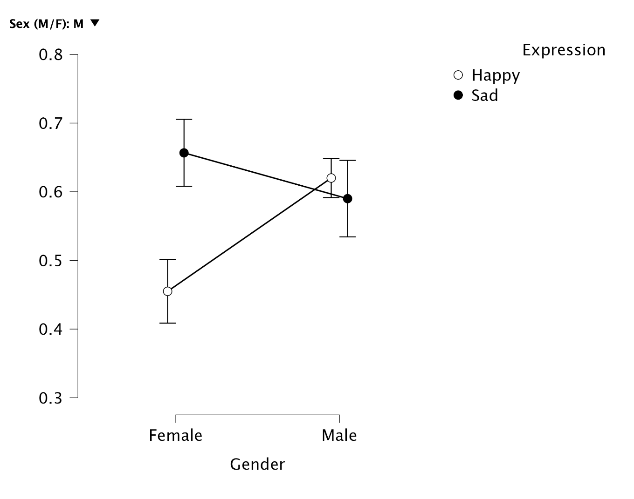
Descriptives Plots (Without Outline)
(Male Participants)
(Female Participants)

Slide 33
WITH OUTLINE
WITHOUT OUTLINE
(Female Participants)
(Female Participants)

Slide 34
WITH OUTLINE
WITHOUT OUTLINE
(Male Participants)
(Male Participants)

Slide 35
All participants:
Remember sad expression better than happy expression on both gender of images.
Happy Expression: participants remember men faces better than women faces.
Female Participants:
Remember women face better than male faces on both expression.
Remember sad expression better than happy expression on both gender of images.
Male Participants:
Sad Expression: remember sad women faces better than happy women faces.
Happy Expression: remember happy men faces better than sad men faces.
Notes:
Implications and Conclusions (typically 2-3 slides). Correctly interpret your results. Constructively address sources of error and methodological difficulties. Place your results in context and draw implications from them.

Slide 36
CONCLUSION
Notes:
Implications and Conclusions (typically 2-3 slides). Correctly interpret your results. Constructively address sources of error and methodological difficulties. Place your results in context and draw implications from them.

Slide 37
CONCLUSION
In conclusion, we cannot find the evidence to reject the null hypothesis because all of the p-value is greater than 0.05. Thus, there are not significant relationship between the facial expression and genders of a person to memory.
Limitation
Not enough participants after deleting outliers.
The test was too easy.
Expression were not clear/distinguish enough.
Notes:
Implications and Conclusions (typically 2-3 slides). Correctly interpret your results. Constructively address sources of error and methodological difficulties. Place your results in context and draw implications from them.

Slide 38
ACKNOWLEDGMENTS
Notes:
Acknowledgments (1 slide). Thank anyone who provided advice or assistance. Verbally thank your audience for their attention and tell them you would be happy to answer any questions.

Slide 39
I would like to express my special thanks and gratitude to my professor David Dilgren who gave me the golden opportunity to do this wonderful project, which also helped me in doing a lot of research and I came to know about so many new things. I am really thankful to them.
Secondly, I would also like to thank my friends who helped me complete this project by either taking the experiment or providing me knowledge on the data.
Again, thanks for everyone who helped me complete this project!
Notes:
Acknowledgments (1 slide). Thank anyone who provided advice or assistance. Verbally thank your audience for their attention and tell them you would be happy to answer any questions.

Slide 40
QUESTIONS?

Slide 41
THANK
YOU

